Slide 1
Design Modeling with UML: Design Sequence Diagram
Instructor: Mehroze Khan

Slide 2
Designing the Solution!
Introduction to Design Phase
Static vs. Dynamic Design Modelling
Interaction Diagrams
Design Class Diagrams

Slide 3
Modelling Dynamic Behavior
The UML includes interaction diagrams to illustrate how objects interact via messages.
They are used for dynamic object modeling.
Static OO design will be presented as Class Diagram.

Slide 4
Sequence Diagram
Sequence diagram simply depicts interaction between objects in a sequential order (i.e. the order in which these interactions take place.)
Sequence diagrams describe how and in what order the objects in a system function

Slide 5
Sequence Diagram
They illustrate how the different objects in a system interact with each other to carry out a function, and the order in which the interactions occur when a particular use case is executed

Slide 6
Interaction diagrams are used to visualize the interaction via messages between objects; they are used for dynamic object modeling.

Slide 7
Example of Sequence Diagram
:A
objB:B
one
two
three

Slide 8
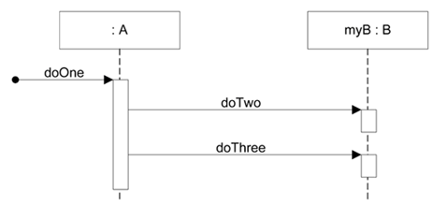
Sequence diagrams
Sequence diagrams illustrate interactions in a kind of fence format, in which each new object is added to the right
public class A
{
private B myB = new B();
public void doOne()
{
myB.doTwo();
myB.doThree();
}
// …
}
Notes:
Probably, that class A has a method named doOne and an attribute of type B. Also, that class B has methods named doTwo and doThree

Slide 9
Illustrating Classes and Instances
UML instances and named instances

Slide 10

Format for Interaction Messages
Interaction diagrams show messages between objects; the UML has a standard syntax for these message expressions
return = message(parameter:parameterType):returnType
Parentheses are usually excluded if there are no parameters. Type information may be excluded if unimportant.
initialize
initialize(code)
d = getProductDescription (id)
d | = | getProductDescription | (id : | ItemId)
d | = | getProductDescription | (id : | ItemId) : | ProductDescription

Slide 11
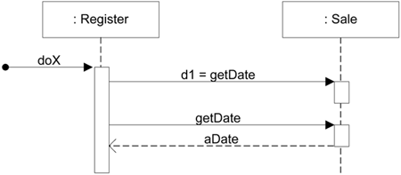
Two ways to show a return result from a message

Slide 12
Two ways to show a return result from a message

Slide 13
Two ways to show a return result from a message
:Register
:Sale
report
Variant A
theReport = report
:Register
:Sale
report
report
theReport
Variant B

Slide 14
Modeling (Synchronous) Messages
a message whose sender will not be specified
typical synchronous message shown with a filled-arrow
:Register
:Sale
report
getDate
Date
execution specification bar indicates focus of control
getSale
Notes:
The execution specification bar, also known as the focus of control or activation bar, represents the period during which an object or actor is actively performing an action in a UML sequence diagram. It shows that the object is executing a method, processing an operation, or handling a task during this time.

Slide 15
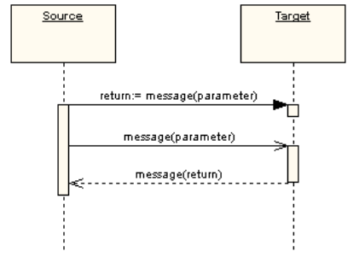
Synchronous and Asynchronous Messages
First message is a synchronous message (denoted by the solid arrowhead) complete with an implicit return message; the second message is asynchronous (denoted by line arrowhead), and the third is the asynchronous return message (denoted by the dashed line).
:
:

Slide 16
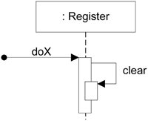
Messages to "self" or "this"
Messages to "self" or "this"
A message can be sent from an object to itself. This is illustrated by a link to itself, with messages flowing along the link.

Slide 17
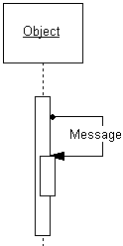
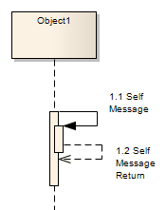
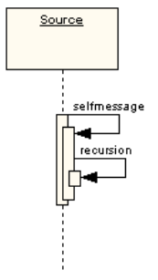
Self Messages
A self message can represent a recursive call of an operation, or one method calling another method belonging to the same object. It is shown as creating a nested focus of control in the lifeline’s execution occurrence.
:
:
:

Slide 18
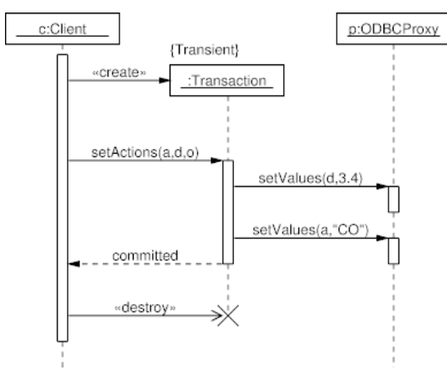
Create and Destroy Messages
Create messages are used to instantiate a new object
Delete/Destroy message is used to delete an object
Newly created objects are placed at their creation “height”.
Notes:
A transient object is an object that is created dynamically during the interaction in a sequence diagram but is not meant to persist throughout the entire lifecycle of the application.
It only exists temporarily during the execution of a particular operation or interaction and may be discarded or removed once its purpose is fulfilled.

Slide 19
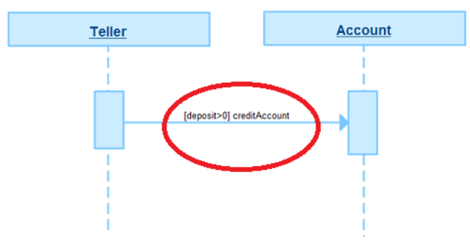
Guards
When modeling object interactions, there will be times when a condition must be met for a message to be sent to the object.
Guards are used throughout UML diagrams to control flow.
:
:

Slide 20
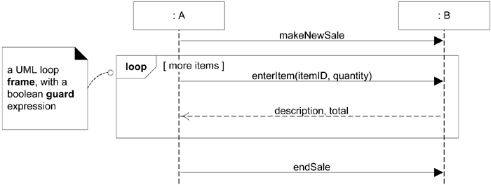
Diagram Frames in UML Sequence Diagrams
To support conditional and looping constructs (among many other things), the UML uses frames.
Frames are regions or fragments of the diagrams; they have an operator or label (such as loop) and a guard (conditional clause).

Slide 21
Frame Operator
Frame Operator | Meaning
alt | Alternative fragment for mutual exclusion conditional logic expressed in the guards.
loop | Loop fragment while guard is true. Can also write loop(n) to indicate looping n times.
opt | Optional fragment that executes if guard is true.
par | Parallel fragments that execute in parallel.

Slide 22
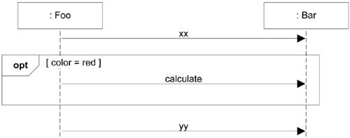
Conditional Messages
An OPT frame is placed around one or more messages.
Notice that the guard is placed over the related lifeline

Slide 23
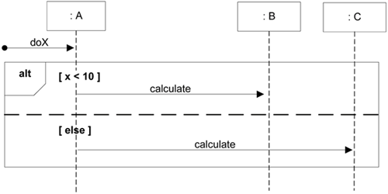
Mutually Exclusive Conditional Messages
An ALT frame is placed around the mutually exclusive alternatives

Slide 24
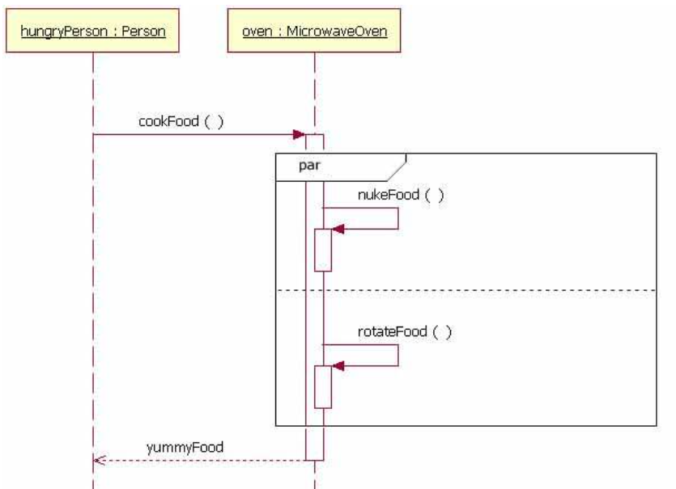
Parallel Frame
When the processing time required to complete portions of a complex task is longer than desired, some systems handle parts of the processing in parallel.
The parallel combination fragment element needs to be used when creating a sequence diagram that shows parallel processing activities.

Slide 25
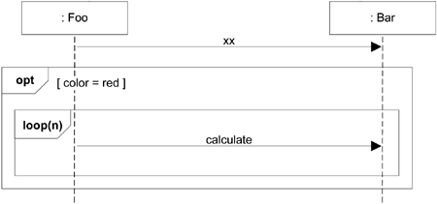
Nesting of Frames
Frames can be nested

Slide 26


Use a UML loop frame to iterate over a collection
:Sale
lineItems[i] : SalesLineItem
t = getTotal
loop
[for each sales line item]
st = getSubTotal
Modeling task: Calculate the total of a sale by summing up the sub totals for each sales line item.
Notes:
This indicates that lineitems is a collection, array, or list that holds multiple SaleLineItem objects.

Slide 27

How to model the sending of a message only if a guard condition matches?
Modeling task: Get the sum of all sales that happened before a specific date.

Slide 28


Use a UML opt frame to model the sending of a message if the guard condition matches.
: Register
sales[i] : Sale
r = getTotal(endDate)
loop
[for each sale]
date = getDate
opt
[date < endDate]
t = getTotal
Frames can be nested

Slide 29
References
Larman, Craig. Applying UML and patterns: an introduction to object-oriented analysis and design and interactive development. Pearson Education India, 2012.
Object-Oriented Analysis and Design with Applications, Grady Booch et al., 3rd Edition, Pearson, 2007.
Timothy C. Lethbridge, Robert Laganaiere, Object-Oriented Software Engineering (2nd Edition), McGraw Hill, 2005
Object-Oriented Modeling and Design with UML, Michael R. Blaha and James R. Rumbaugh, 2nd Edition, Pearson, 2005.

